Slide 1
Convolutional neural networks

Slide 2
Agenda
Neural Networks (Why it cannot be used?)
CNN architecture
Famously used CNN Models
Applications of CNN

Slide 3
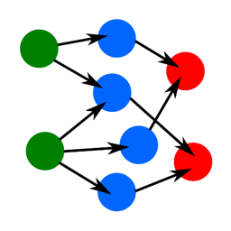
What are Neural Networks ?
Artificial neural networks or connectionist systems are computing systems vaguely inspired by the biological neural networks that constitute animal brains. Such systems "learn" to perform tasks by considering examples, generally without being programmed with task-specific rules.

Slide 4
Neural Networks VS Machine Learning Algorithms
In practical terms, deep learning is just a subset of machine learning. In fact, deep learning technically is machine learning and functions in a similar way (hence why the terms are sometimes loosely interchanged). However, its capabilities are different.
While basic machine learning models do become progressively better at whatever their function is, but they still need some guidance. If an AI algorithm returns an inaccurate prediction, then an engineer must step in and reflect changes. With a deep learning model, an algorithm can determine on its own if a prediction is accurate or not through its own neural network.

Slide 5
Shortcomings of Artificial Neural Networks (ANN)
► Hardware dependence: Artificial neural networks require processors with parallel processing power, in accordance with their structure. For this reason, the realization of the equipment is dependent.
► Unexplained behavior of the network: This is the most important problem of ANN. When ANN produces a probing solution, it does not give a clue as to why and how. This reduces trust in the network.
► Determination of proper network structure: There is no specific rule for determining the structure of artificial neural networks. Appropriate network structure is achieved through experience and trial and error.
► Difficulty of showing the problem to the network: ANNs can work with numerical information. Problems have to be translated into numerical values before being introduced to ANN. The display mechanism to be determined here will directly influence the performance of the network . This depends on the user's ability.
► The duration of the network is unknown: The network is reduced to a certain value of the error on the sample means that the training has been completed. This value does not give us optimum results.

Slide 6
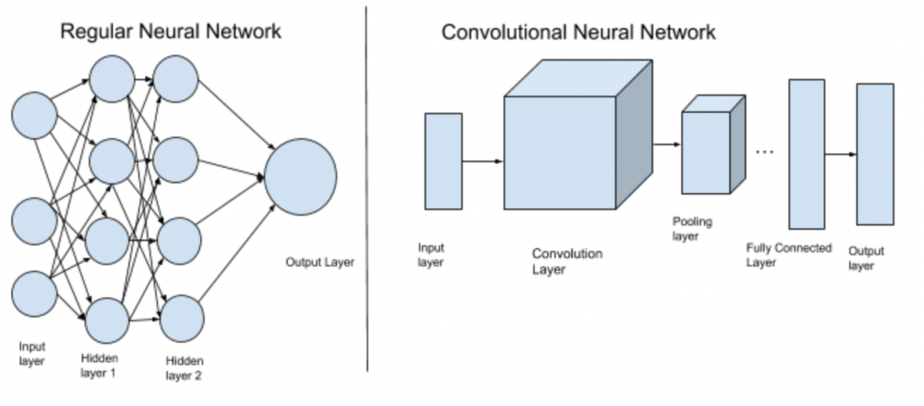
Convolutional neural network
In deep learning, a convolutional neural network is a class of deep neural networks, most commonly applied to analysing visual imagery. They are also known as shift invariant or space invariant artificial neural networks, based on their shared-weights architecture and translation invariance characteristics.

Slide 7
Artificial Neural Network VS Convolutional Neural Network
Neural Networks (NN), or more precisely Artificial Neural Networks (ANN), is a class of Machine Learning algorithms that recently received a lot of attention (again!) due to the availability of Big Data and fast computing facilities (most of Deep Learning algorithms are essentially different variations of ANN).
The class of ANN covers several architectures including Convolutional Neural Networks (CNN), Recurrent Neural Networks (RNN) eg LSTM and GRU, Autoencoders, and Deep Belief Networks. Therefore, CNN is just one kind of ANN.
Generally speaking, an ANN is a collection of connected and tunable units (a.k.a. nodes, neurons, and artificial neurons) which can pass a signal (usually a real-valued number) from a unit to another. The number of (layers of) units, their types, and the way they are connected to each other is called the network architecture.
A CNN, in specific, has one or more layers of convolution units. A convolution unit receives its input from multiple units from the previous layer which together create a proximity. Therefore, the input units (that form a small neighborhood) share their weights.

Slide 8
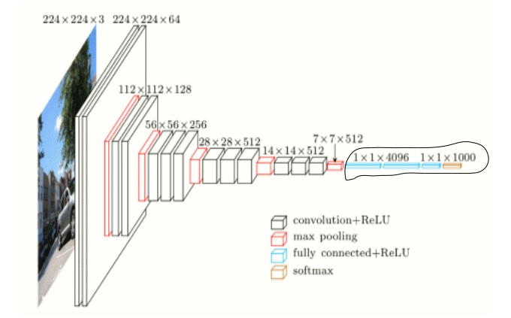
Convolutional Neural Network Architecture
There are four types of layers for a convolutional neural network: the convolutional layer, the pooling layer, the ReLU correction layer and the fully-connected layer.

Slide 9
The convolutional layer
The convolutional layer is the key component of convolutional neural networks, and is always at least their first layer.
Its purpose is to detect the presence of a set of features in the images received as input. This is done by convolution filtering: the principle is to “drag” a window representing the feature on the image, and to calculate the convolution product between the feature and each portion of the scanned image. A feature is then seen as a filter: the two terms are equivalent in this context.
The convolutional layer thus receives several images as input, and calculates the convolution of each of them with each filter. The filters correspond exactly to the features we want to find in the images.
We get for each pair (image, filter) a feature map, which tells us where the features are in the image: the higher the value, the more the corresponding place in the image resembles the feature.
Unlike traditional methods, features are not pre-defined according to a particular formalism (for example SIFT), but learned by the network during the training phase! Filter kernels refer to the convolution layer weights. They are initialized and then updated by backpropagation using gradient descent.

Slide 10
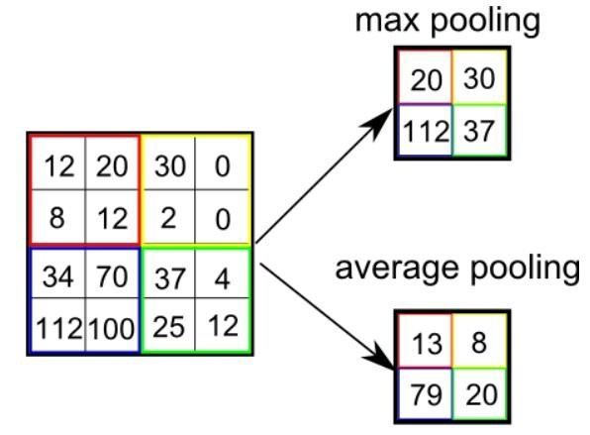
The pooling layer
This type of layer is often placed between two layers of convolution: it receives several feature maps and applies the pooling operation to each of them.
The pooling operation consists in reducing the size of the images while preserving their important characteristics.
The pooling layer reduces the number of parameters and calculations in the network. This improves the efficiency of the network and avoids over-learning.

Slide 11
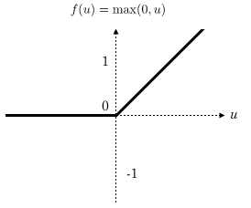
The ReLU correction layer
ReLU (Rectified Linear Units) refers to the real non-linear function defined by ReLU(x)=max(0,x).
The ReLU correction layer replaces all negative values received as inputs by zeros. It acts as an activation function.

Slide 12
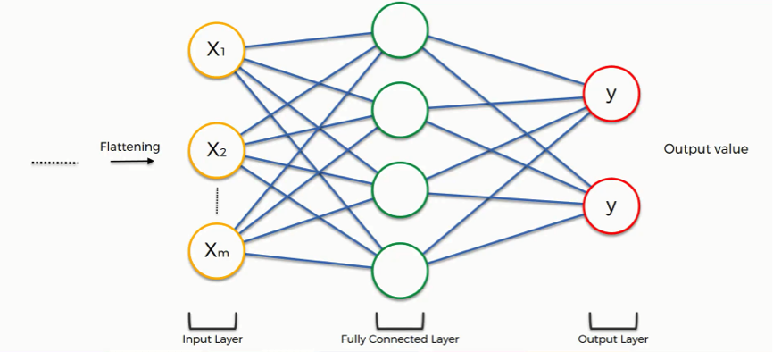
The fully-connected layer
The fully-connected layer is always the last layer of a neural network, convolutional or not — so it is not characteristic of a CNN.
This type of layer receives an input vector and produces a new output vector. To do this, it applies a linear combination and then possibly an activation function to the input values received.
The last fully-connected layer classifies the image as an input to the network: it returns a vector of size N, where N is the number of classes in our image classification problem. Each element of the vector indicates the probability for the input image to belong to a class.
The convolutional neural network learns weight values in the same way as it learns the convolution layer filters: during the training phase, by backpropagation of the gradient.

Slide 13
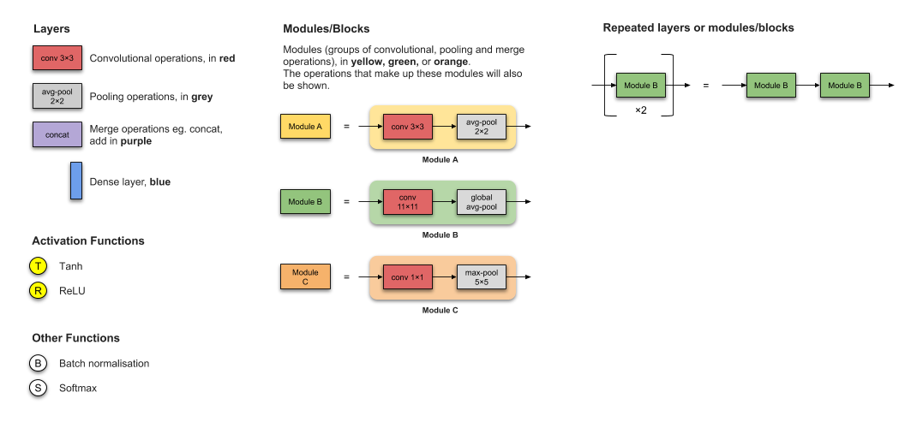
CNN Architectures
LeNet-5
AlexNet
VGG-16
Inception-v1
Inception-v3
ResNet-50
Xception
Inception-v4
Inception-ResNets
ResNeXt-50

Slide 14
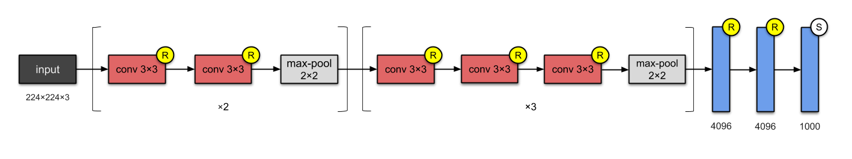
VGG 16 (2014)
The folks at Visual Geometry Group (VGG) invented the VGG-16 which has 13 convolutional and 3 fully-connected layers, carrying with them the ReLU tradition from AlexNet. This network stacks more layers onto AlexNet, and use smaller size filters (2×2 and 3×3). It consists of 138M parameters and takes up about 500MB of storage space 😱. They also designed a deeper variant, VGG-19.

Slide 15
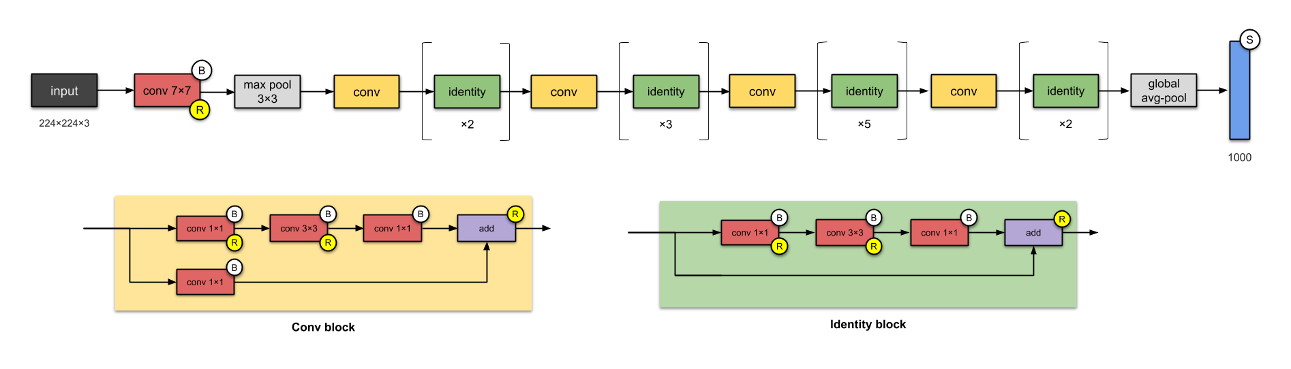
ResNet-50 (2015)
The folks from Microsoft Research built ResNet — using skip connections (a.k.a. shortcut connections, residuals), while building deeper models.
ResNet is one of the early adopters of batch normalisation.
Batch normalization is a technique for improving the speed, performance, and stability of artificial neural networks. It is used to normalize the input layer by adjusting and scaling the activations.
The basic building block for ResNets are the conv and identity blocks.

Slide 16
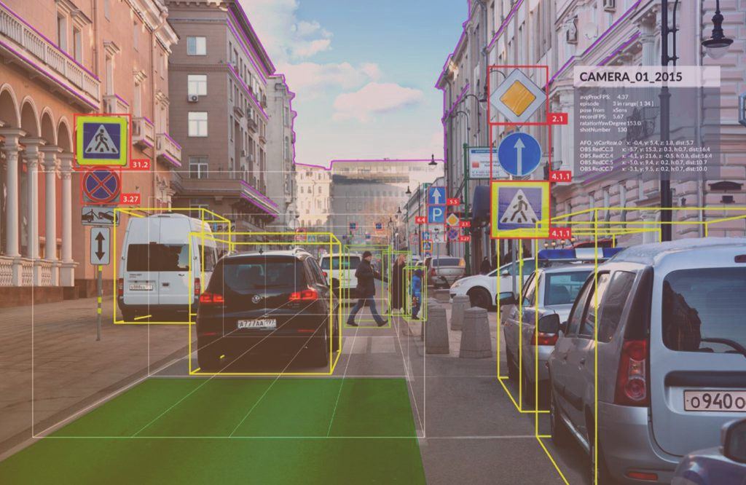
Applications of CNN
Image recognition and OCR
Object detection for self-driving cars
Face recognition on social media
Image analysis in healthcare

Slide 17
CNN Execution IN Realtime
https://cs.stanford.edu/people/karpathy/convnetjs/demo/mnist.html

